Slide 1

Pack Meeting Pack 232
January 21st 2020

Slide 2
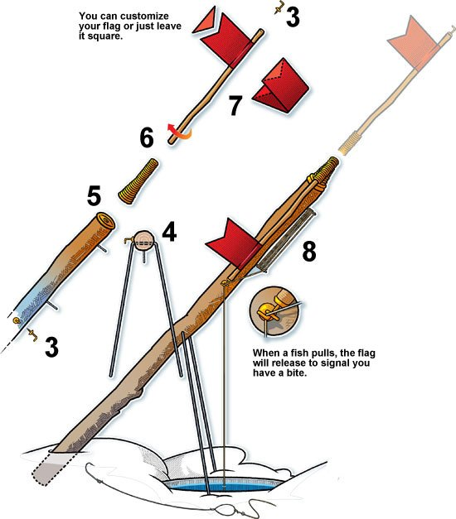
Making Ice Fishing Tip-Ups
SUPPLIES
1 Thick Dowel Piece
1 Thin Dowel Piece
1 Wire
A piece of Duct Tape
Instructions
Place Wire through Drilled Hole in Thick Dowel Piece to make the legs
Twist Thin Dowel Piece into spring in top of Thick Dowel Piece
Make a flag using the Duct Tape
Write your name on your tip up and color it with markers/crayons

Slide 3
Pack Meeting – Jan. 21st
Gathering – Make Ice Fishing Tip-Ups
Opening – Pledge/Oath/Law/Outdoor Code
Program – Ice Fishing Presentation
Game – M&M Separation Anxiety
Recognition - Awards
Snacks
Announcements
Cubmaster’s Minute

Slide 4
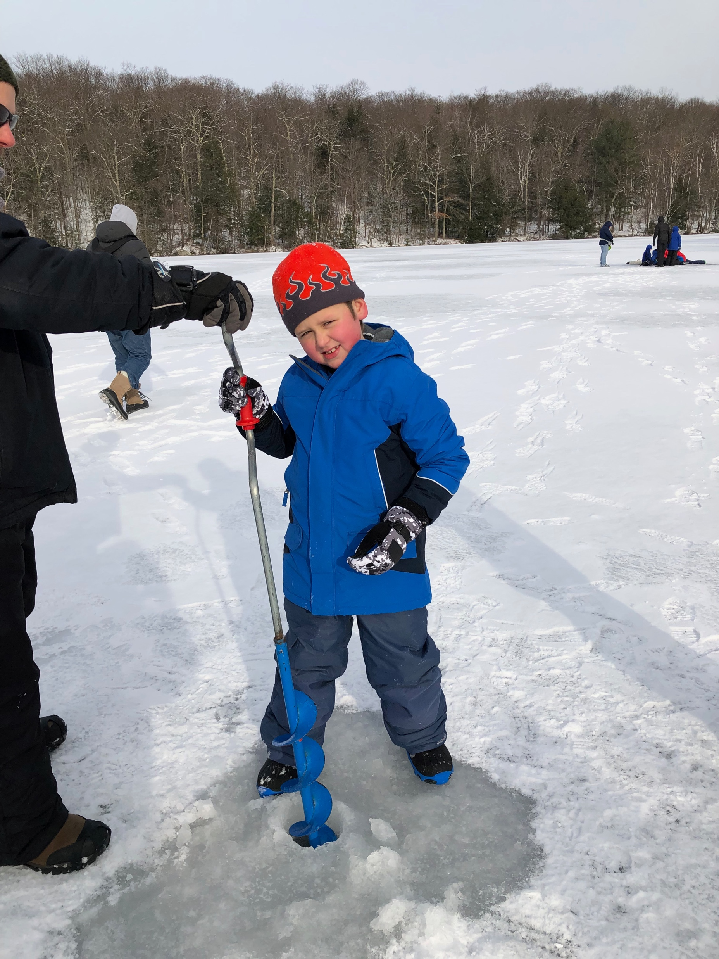
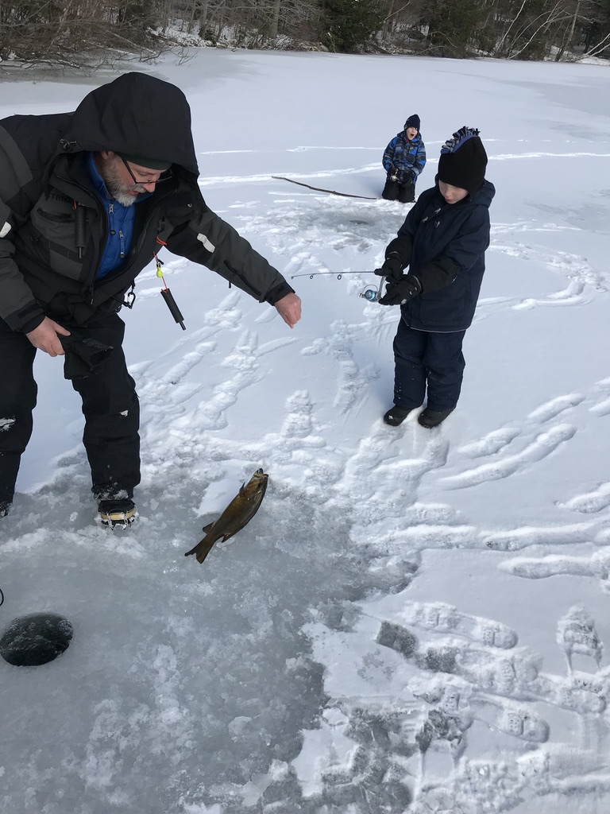
Ice Fishing Presentation

Slide 5
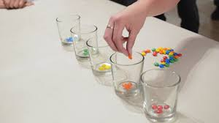
M&M Separation Anxiety

Slide 6
Awards and Den Reports

Slide 7
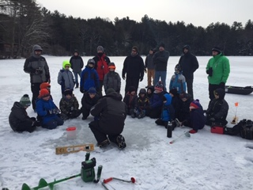
Winter Camping – 2/07-2/09 10 spots left!
Items to Pack:
Sleeping Bag
Pillow
A sleeping pad (your back will thank you)
Ear plugs (if you like to sleep peacefully)
Waterproof Boots for outdoors
Slippers/Sneakers/Crocs for inside cabins
Head lamp/flashlight with extra batteries
Toiletries including hand sanitizer and one roll of TP
A cup with your name marked on it
Non-electronic games
1 gallon of bottled water per person
Thermal underwear
Extra pair of wool socks
Snow pants
Hat and gloves/mittens
Ice cleats (e.g. Yak Trax) are recommended
Ice skates (optional)
Ice fishing gear (optional)
Sunglasses (optional)
Cub Scout manual
Helmet for Cub Scout to sled
Snacks
Medication
Location = Rotary Scout Reservation (279 Davitt Lake Road, Poestenkill)
Cost = $20/person (please provide a check to Mr. McWilliam)
REQUIRED Forms:
BSA Medical Forms – Parts A&B
BSA Permission Slip
BANNED ITEM: Alcohol

Slide 8

For Wolves (2nd Grade) - Arrow of Lights (5th Grade).
Teaching problem solving, programming, team building, and much more!
Build your own Raspberry Pi computer! and take it home!
When = 9am-3pm
Cost = $275

Slide 9
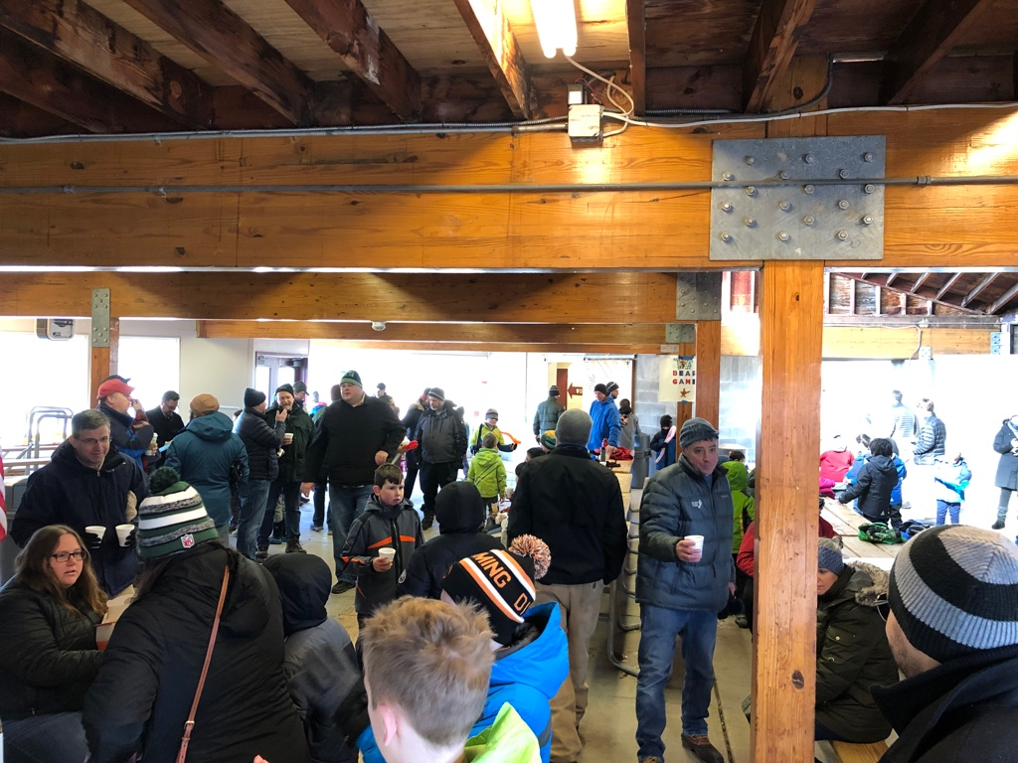
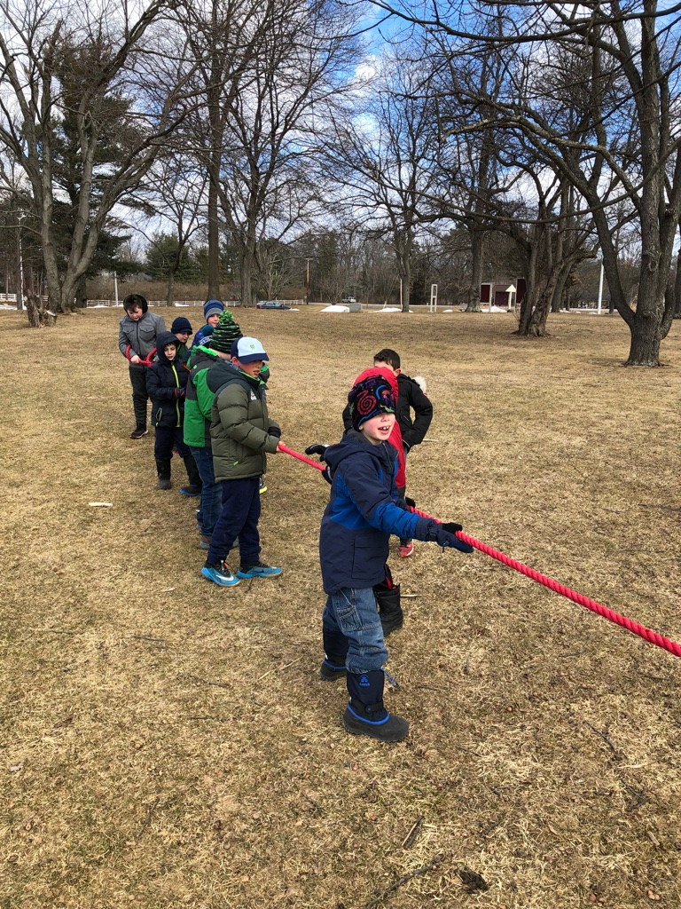
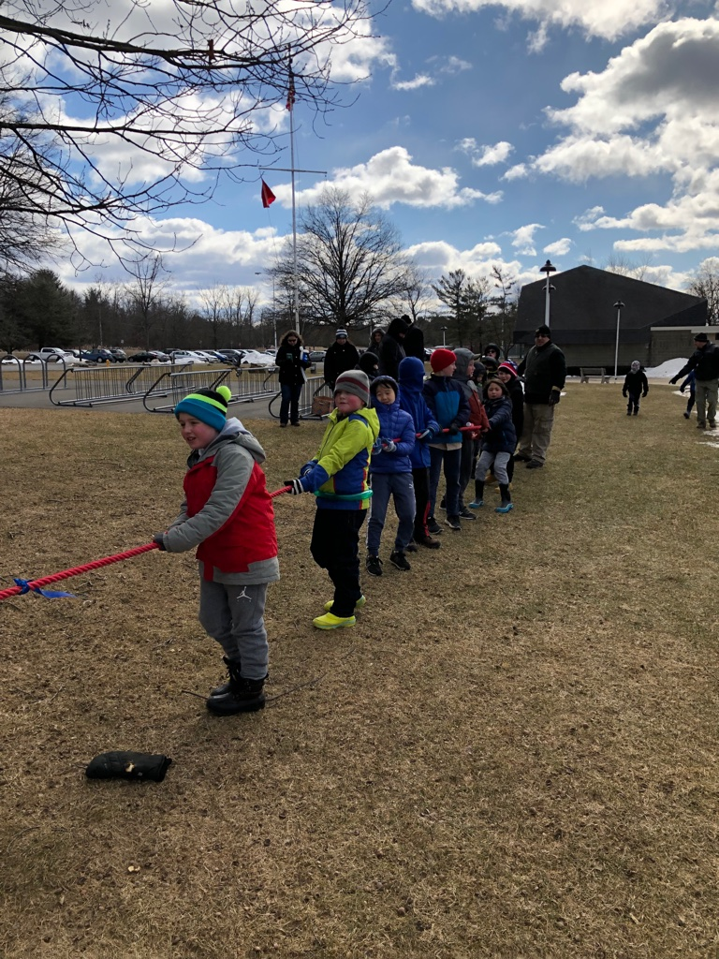
Bethlehem Cub Scout Winter Carnival Elm Ave Park, Sat. 2/29 10am-Noon
Bethlehem Cub Scout Packs 23, 232, 258 and 272 to attend
Cost = Free!
Agenda:
Indoor games designed by each Pack’s Bears den
Opening
Games
Massive Tug of War
Refreshments = hot chocolate and munchkins
SIGN UP ON THE PACK WEBSITE

Slide 10
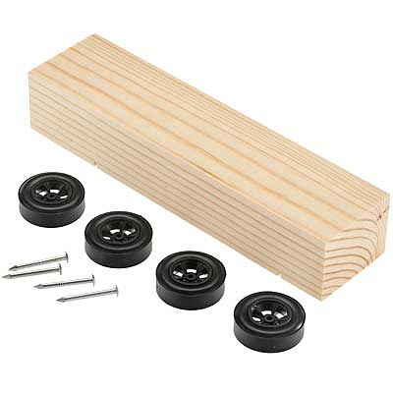
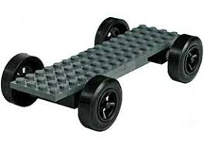
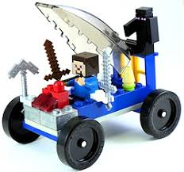
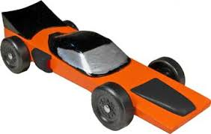
Pinewood Derby Sat. March 7 at Town Hall (9am)
Tigers – Arrow of Light
Lions

Slide 11
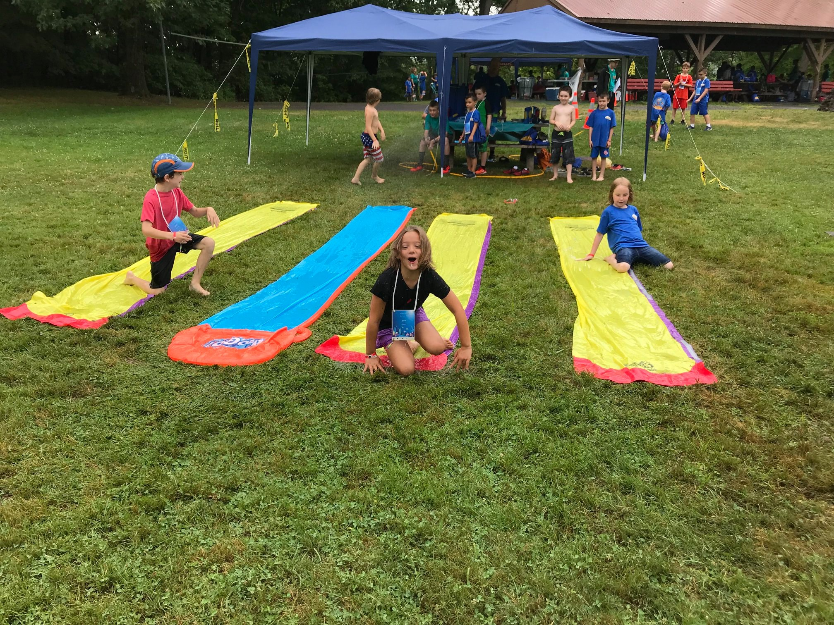
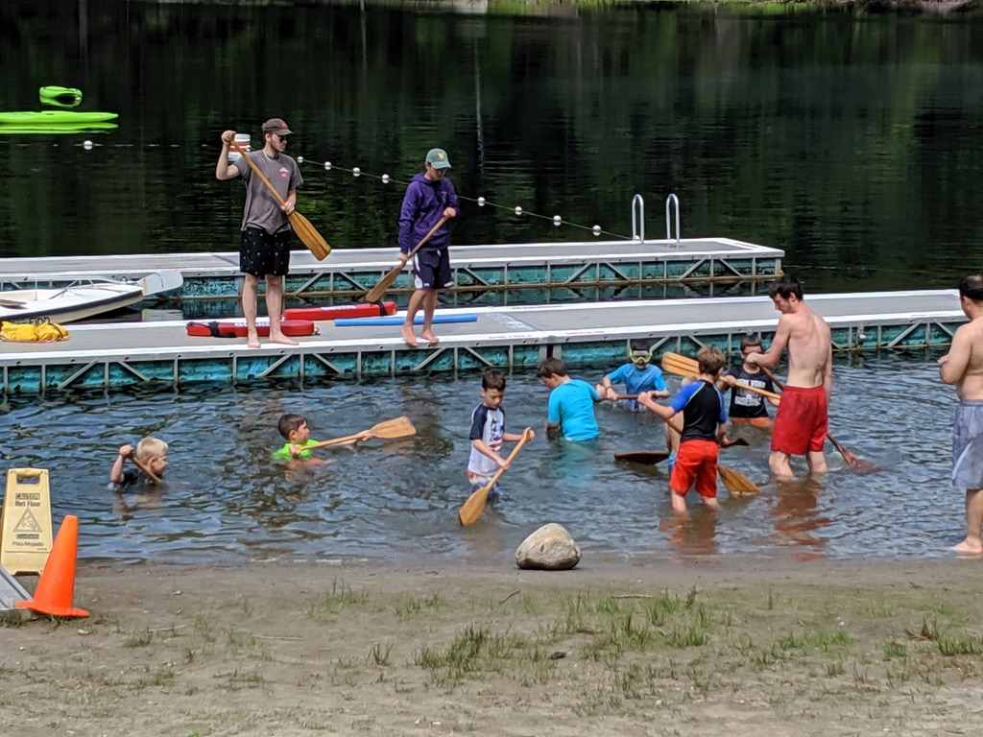
SAVE THE WEEKS Cub Scout Summer Camps
Day Camp (8:30am – 4:30pm) at Rotary (Down on the Farm Theme)
Dates = 7/20 – 7/24
Cost = $175/scout
Bus Shuttle Option is TBD
BSA Health Form Parts A&B
Resident Camp (5 days / 4 nights) at Rotary (Theme TBD)
Dates = 8/02 – 8/06
Cost = $275/scout
BSA Health Form Parts A, B &C (Doctor Physical)
At a minimum, at all times, the Pack must have two adults at Rotary
Beyond 12 enrolled cub scouts, the Pack must provide 1 adult to 6 cub scouts coverage
Adults who attend the entire camp MUST be registered with BSA

Slide 12
Other Pack Events
Howe Caverns = 3/28
Visit a Blacksmith Forge = 4/25 (To Be Confirmed)
Cub Scout Day at Rotary (Harry Potter Theme) = 5/02
Spring Hike = 5/17
USS Slater Sleepover = 6/05 – 6/06
Blue & Gold = 6/07

Slide 13

Pinewood Derby Team
Membership Team (being on a PTA at Glenmont or Eagle & social media expertise is a plus)

Slide 14
Next Pack Meeting Tuesday, February 25 (6:30PM-8PM)
Tigers (1st Grade) Den is the Host
Gathering – Balloon Popping
Program – Knife Safety / Whittling
Game – Cubmaster Challenge
Awards
Snacks

Slide 15
Cubmaster’s Minute
Hibernation means to sleep through the winter. In New York, black bears, woodchucks, some mice and some bats as well as turtles, frogs, salamanders and snakes hibernate. That list is not complete since certain scouts and adults left to their own devices can “hibernate” too; they would rather stay home and watch tv and play video games than go outside when it is cold and there is snow on the ground. Let’s leave hibernation to the animals!
On February 7, we are going to put the outing in Scouting! Pack 232 will show everyone that we know how to have fun outdoors even in winter weather. We’re going to play on the ice, ice fish, sled, hike, build campfires and have lots of fun outside at Rotary Scout Reservation.

